Slide 1
Capstone Project 2: Property Valuation in New York City
Marcus Bamberger

Slide 2
The Goal
Total NYC 2020 property value: 1.4 trillion
How do we price a property?
Housing Valuation: Property Tax Calculation
Department of Finance
Predict housing valuation from property data
Potential secondary application: Fraud detection?

Slide 3
NYC OpenData
Free public data published by NYC
Dataset: 5.7 million valuations, 2010-2017
117 columns of data
Class 1 (residential) data only
Additional verification with Zillow

Slide 4
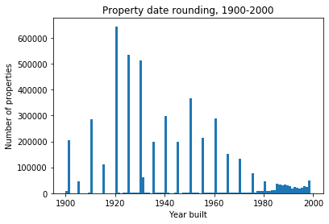
Data Cleaning
All unused/superfluous/homogenous data cut
Target variable: Property valuation. 24 permutations?
Selected ‘Final Actual Assessed Total Value’.
‘Year Built’ an estimate
Records improve in
aprox. late 1980s

Slide 5
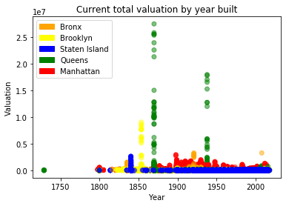
Year built cleaning
Problem: properties ostensibly built in year 0
Solution: replace with mean borough construction year
Finding: zero-year properties
tend to be worth more
Secondary green spike:
partial implementation in
original data?

Slide 6
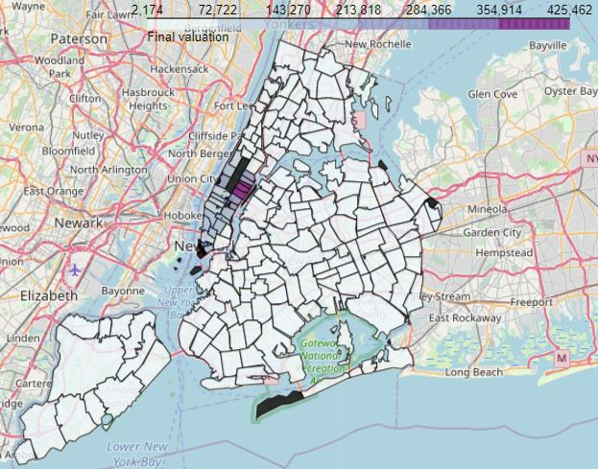
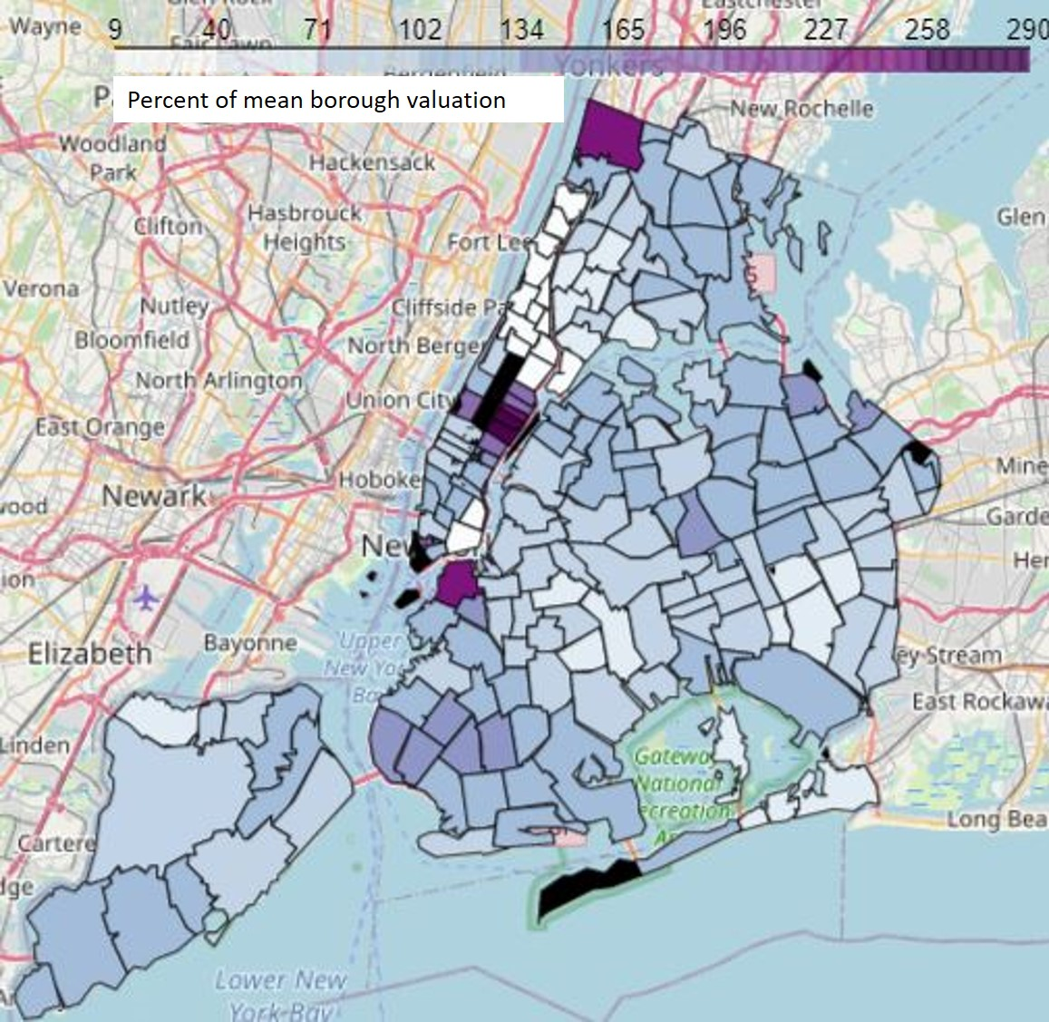
NYC Boroughs
Extremely important feature
Manhattan data orders of magnitude
higher
Chloropleth map cannot map
Manhattan and rest of NYC
Solution: Map percent difference
from mean valuation
Borough data alone: insufficient
for complex modeling

Slide 7
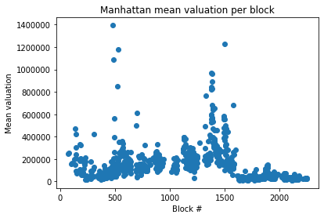
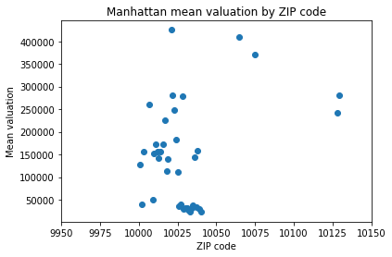
Higher-Resolution Geography
Block-by-block: Relevant, but correlated
to borough data, difficult to map
Solution: Go to ZIP code data
Easy to obtain relevant geoJSON
Mapping less computationally expensive
Some resolution lost in process

Slide 8
Other key factors
Gross square footage
Land area
Lot frontage
Valuation year
Zoning code

Slide 9
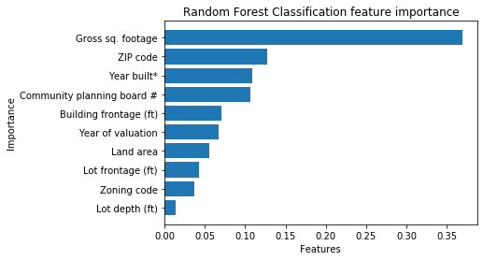
Random Forest Classifier
Problem: Manhattan data is orders of magnitude higher
Solution: Classify based on % of mean borough valuation
Final model: 1000 trees, 0.856 train, 0.841 test, 1% dataset
Trained on 1% of dataset, no benefit to going higher
1.5 minutes to train and run
Good at what it does,
but not very relevant

Slide 10
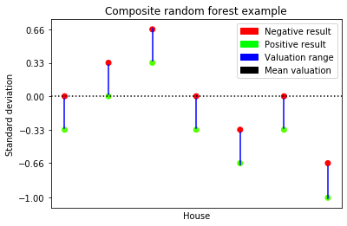
Composite Random Forests
Composite seven classifiers together, each one trained
to predict a different valuation level
Accurately predict 67.7% of all data, placed 96.1% within
one bucket of true
Cumbersome, confusing, not
suited for future work

Slide 11
SGD Regression
Simple, efficient
Trains and runs in seconds
Requires feature scaling
Ultimately unable to properly model dataset

Slide 12
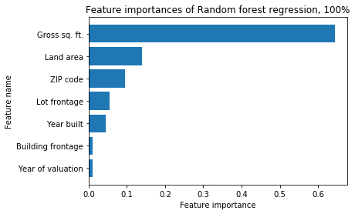
Random Forest Regression
Log(valuation) provides major improvements
Slower than SGD
Like random forest classifier, easy to train on large datasets
Accuracy improves with dataset size
Final model: train 0.719, test
0.716, 100 trees, 100% of dataset
21 minutes to train and run

Slide 13
Target Audience
Real estate valuators
Especially valuable if previous record unavailable
Potential secondary target: Fraud detection?
Would require targeted data, verified fraud
Focus on results, not methods

Slide 14
Future Improvements
More computation power
More data
More columns: Estimated damage/renovation cost
Better geographical tracking
More recent data
What is the current economy doing to property valuation?
Specialized models
Increased targeting, but cannot examine NYC as a whole

Slide 15
Results
Random Forest Classifier: Powerful but inflexible
Composite RFC: More flexible but clunky and unorthodox
SGD: Not powerful enough, requires more robust pipeline
Random Forest Regression: Predicts 71% of total data variation
Supplement real estate valuation, cannot replace

